Slide 1


Correlations of Evaluation Metrics for Voice Conversion: An Experimental Analysis
Arkapravo Nandi¹, Subhayu Ghosh², Md. Tousin Akhter²,
Sandipan Dhar², Nanda Dulal Jana²
¹MCKV Institute of Engineering, West Bengal, India
²National Institute of Technology Durgapur, West Bengal, India

Slide 2
Contents
Introduction
Evaluation Metrics
Dataset Descriptions
Results and Discussions
Conclusion

Slide 3
Introduction
Voice Conversion (VC) refers to conversion of vocal features from source speaker to target speaker without altering linguistic content. It is a part of speech-to-speech literature.
The innovation of VC technologies has expanded its potential usage from personal voice assistive technologies to voice dubbing in the entertainment industry.
Moreover, recent advancements in the field of deep learning, such as GANs and VAEs, over traditional statistical methods like GMM, HMM, and VQ, have led to the production of more naturally sounding speech samples.
Evaluating the quality of converted samples involves analysis of naturalness, degree of similarity, and intelligibility of speech content. These evaluations are carried out through objective and subjective metrics.

Slide 4
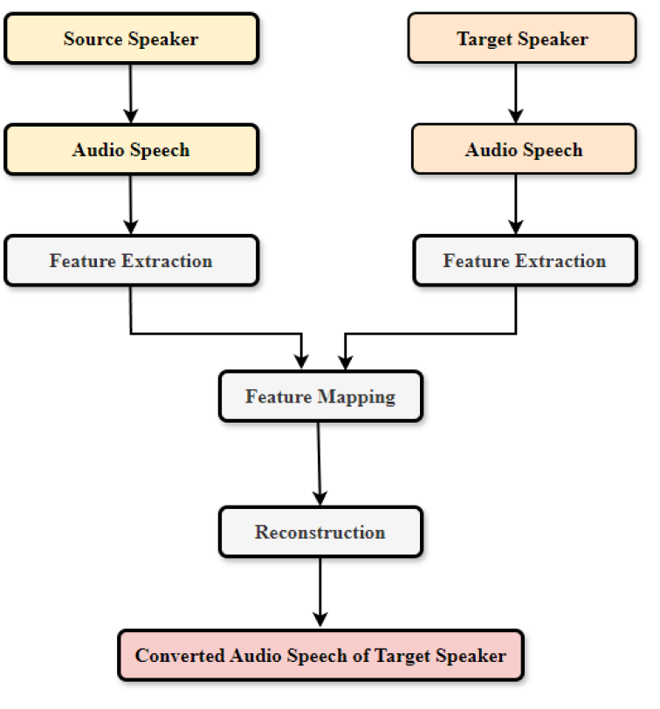
Introduction (contd.)
Fig-1: An Overview of VC pipeline.

Slide 5
Introduction (contd.)
Objective metrics such as mel-cepstral distortion (MCD) and modulation spectra distance (MSD) are used to evaluate certain aspects of voice quality and similarity in a reproducible manner.
Subjective metrics such as mean opinion score (MOS) has been used to capture human perceptions of voice quality and speaker similarity of converted speech samples.
However, the intercorrelation and intra-correlation between these evaluation metrics remains inadequately described in the VC domain, leading to discrepancies in evaluation and comparison of VC systems.
In order to address the challenges posed by manual evaluation and comparison, state-of-the-art (SOTA) VC models were developed, which uses more nuanced and comprehensive evaluation architecture to accurately assess the performance.
Therefore, a detailed investigation of the interplay and correlation between objective and subjective evaluation metrics on SOTA VC models needs to be carried out to address the discrepancies.

Slide 6
Introduction (contd.)
The key contributions of the paper are listed below:
Extensive experiments were carried out to study the correlations between the evaluation metrics, by using the SOTA VC models on CMU Arctic, VCC-2018 and CSTR VCTK datasets.
Both the objective and subjective evaluation metrics involved in VC are analyzed in details to gain valuable insights into the measurement standards employed in this field.
A detailed discussion on correlation study using linear and radar plots were carried out to visualize the strength of relationship between these metrics on each of three datasets described above .

Slide 7
Evaluation Metrics
MCD [1] quantifies the spectral discrepancies between the original audio features and their converted counterparts.
MSD [2] quantifies the local structural differences between the spectral characteristics of the original speech samples and the corresponding converted speech samples.
While MCD primarily evaluates the global characteristics, MSD delves into the finer, local distinctions within the acoustic data.
It is imperative to note that a lower MCD and MSD score signifies a more favorable outcome, indicating a heightened degree of similarity between the original and converted speech samples.

Slide 8
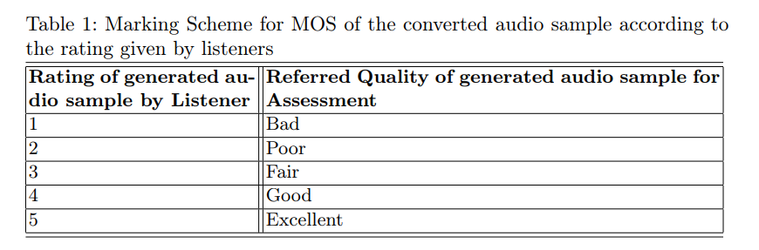
Evaluation Metrics (Contd.)
The primary method employed for evaluating the quality of the converted audio sample is the Mean Opinion Score (MOS).
MOS [3] involves listeners for listening to both the generated audio and the original audio and rate the quality of the generated sample based on their subjective judgment of the similarity between the two.

Slide 9
Datasets Description
CMU Arctic
CMU Arctic dataset [4] consists of 1132 phonetically balanced English speech utterances recorded under studio conditions. It includes 1078 training samples and 54 test samples for each of source and target speaker.
VCC 2018
VCC 2018 dataset [5] contains speech samples of four native American English speakers, two female and two male for each voice conversion task. Each speaker has 81 training speech samples and 35 test speech samples for evaluating the performance of the model.
CSTR VCTK
It consists [6] of English speech samples from 110 speakers, each having their unique style of accent. Greedy algorithm had been employed to randomly choose 400 recorded speech samples, for training of the model.

Slide 10
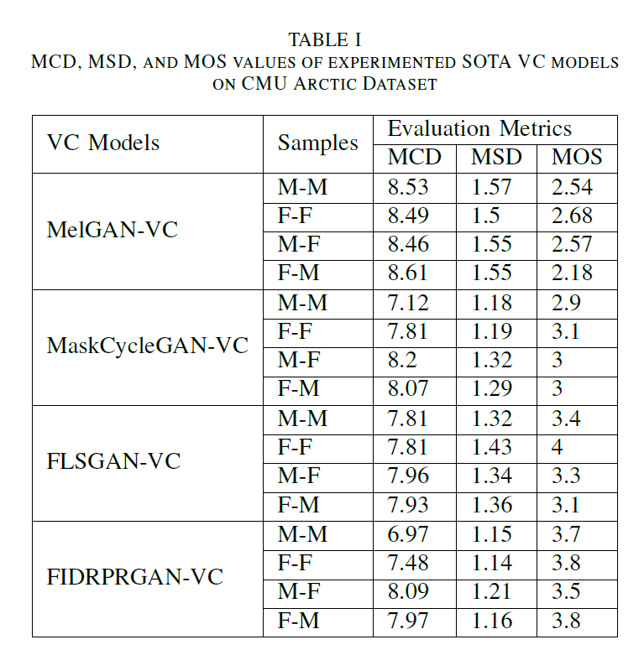
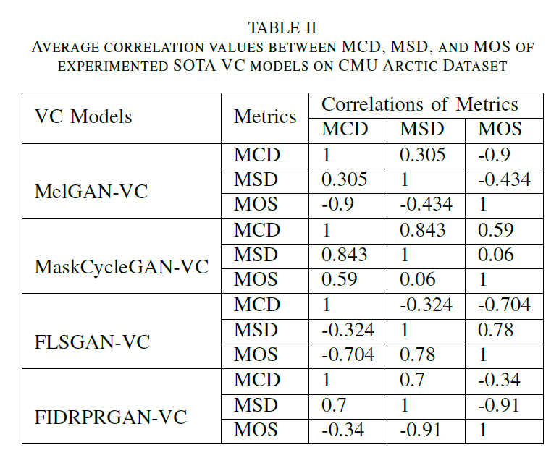
Results and Discussions:

Slide 11
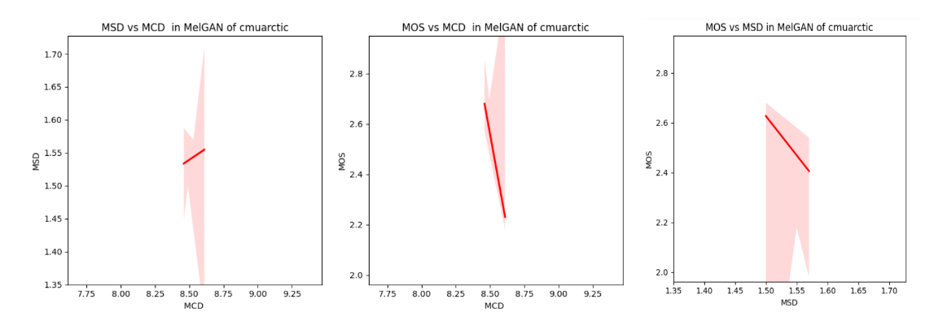
Results and Discussions (Contd.):
Fig-2: Correlation Plots between Objective MetricsMCD , MSD and Subjective Metric MOS for MelGAN-VC on CMU Arctic Dataset

Slide 12
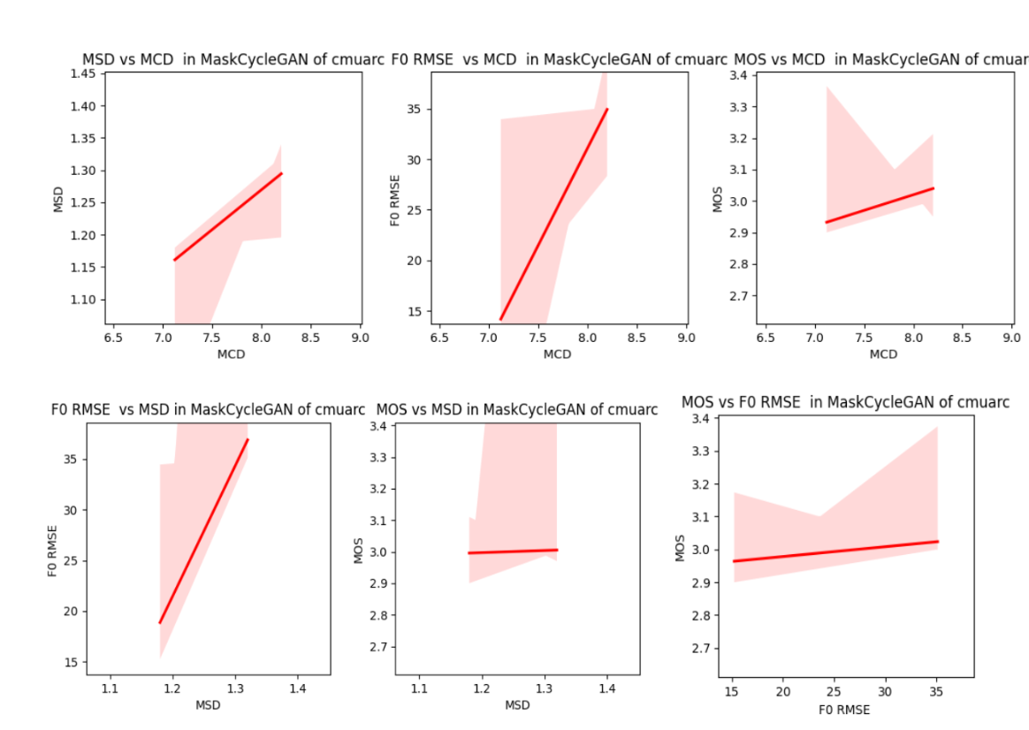
Results and Discussions (Contd.):
Fig-3: Correlation Plots between Objective Metrics MCD , MSD, F0 RMSE and Subjective Metric MOS for MaskCycleGAN-VC on CMU Arctic Dataset .

Slide 13
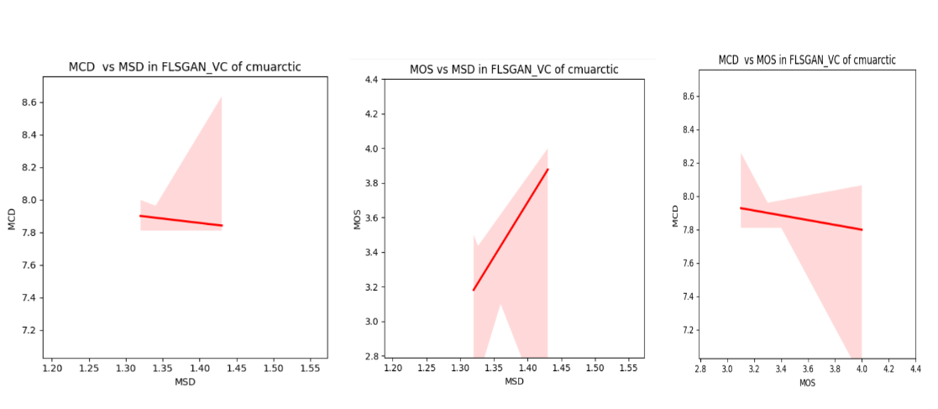
Results and Discussions (Contd.):
Fig-4: Correlation Plots between Objective Metrics MCD , MSD and Subjective Metric MOS for FLSGAN-VC on CMU Arctic Dataset

Slide 14
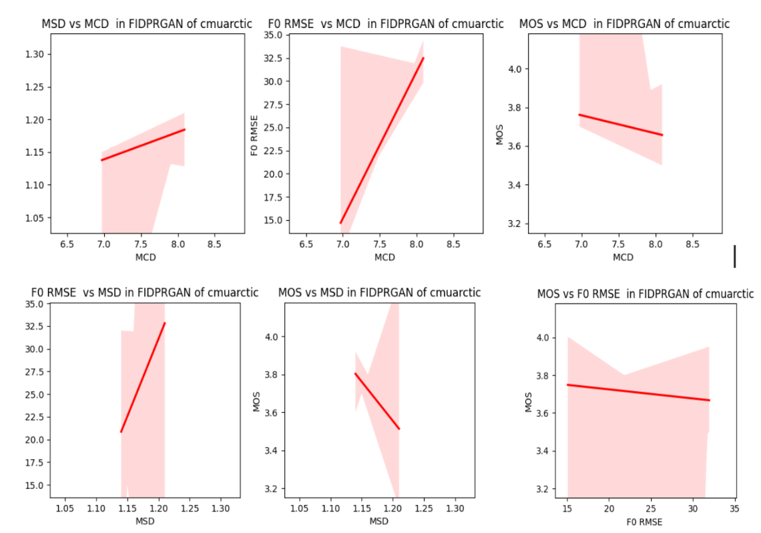
Results and Discussions (Contd.):
Fig-5: Linear Correlation Plots between Objective Metrics MCD , MSD, F0 RMSE and Subjective Metric MOS for FIDPRGAN-VC on CMU Arctic Dataset

Slide 15
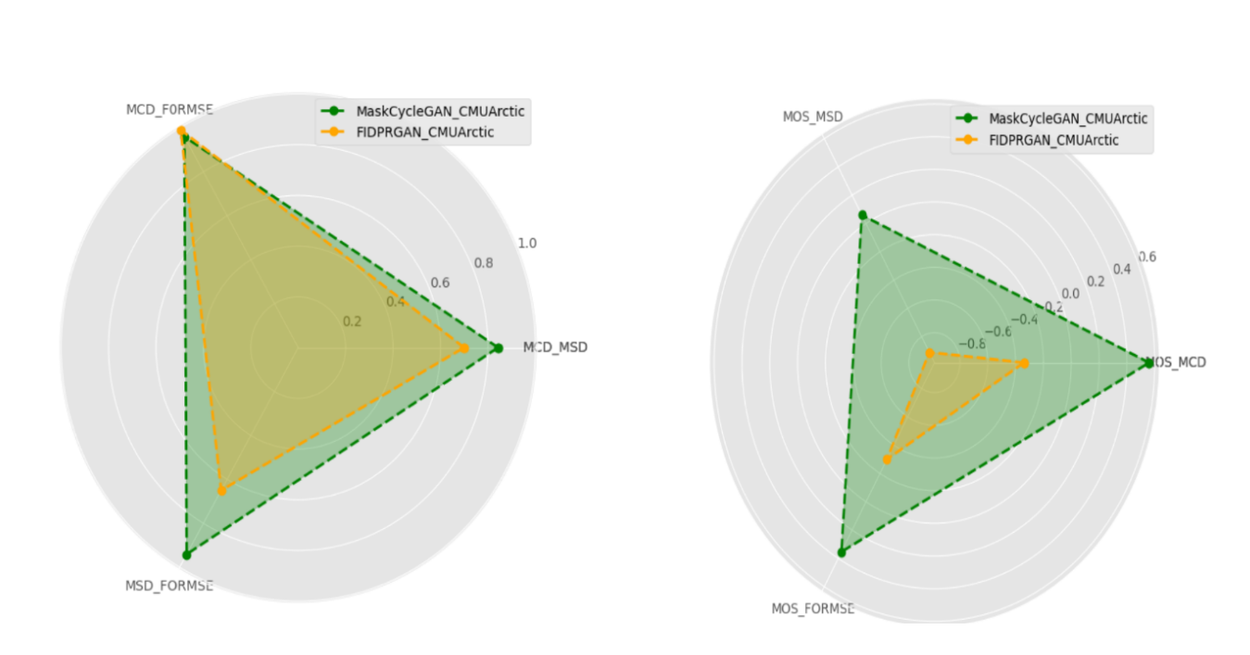
Results and Discussions (Contd.):
Fig-6: Radar Plot showing Intra Class Correlation (from left) and Inter Class Correlation (on right) for voice conversion outputs from MaskCycleGAN and FIDPRGAN

Slide 16
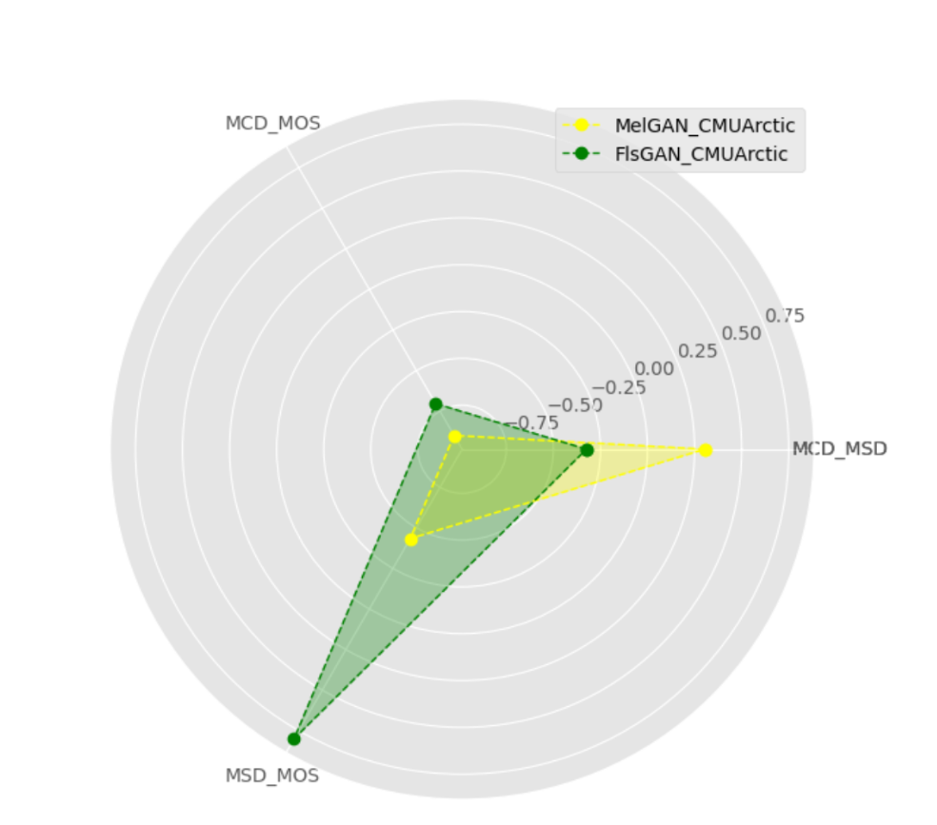
Results and Discussions (Contd.):
Fig-7: Radar Plot showing Intra Class Correlation for voice conversion outputs from MelGAN and FlsGAN

Slide 17
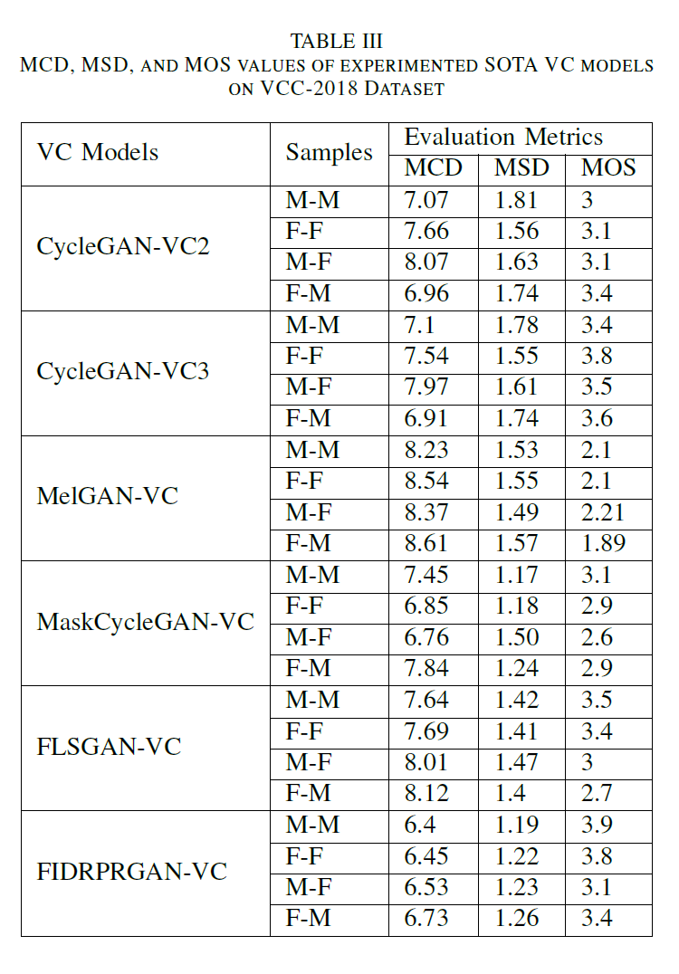
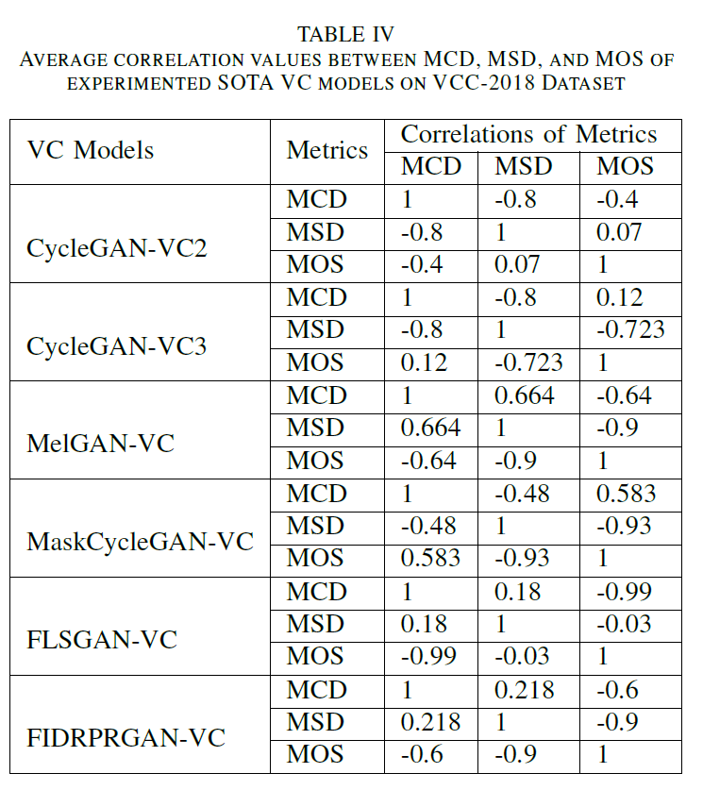
Results and Discussions (Contd.):

Slide 18
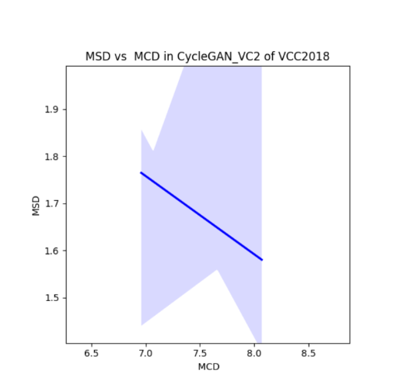
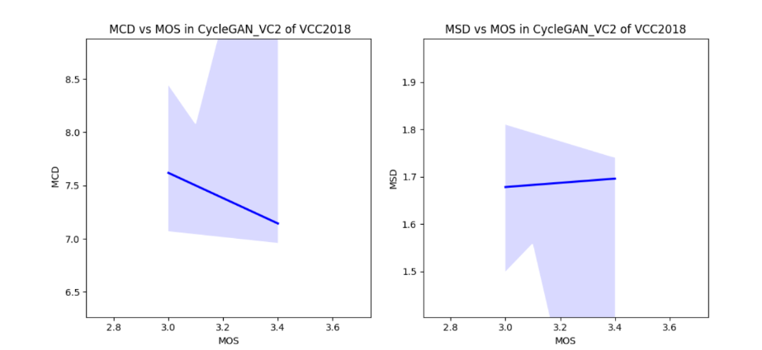
Results and Discussions (Contd.):
Fig-8: Correlation Plots between Objective Metrics MCD , MSD and Subjective Metric MOS for CycleGAN-VC2 on VCC2018 Dataset

Slide 19
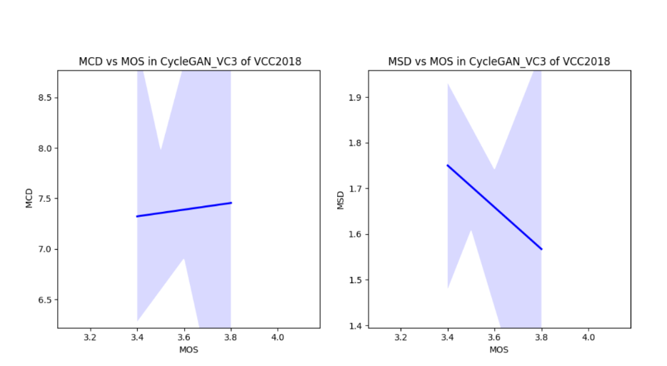
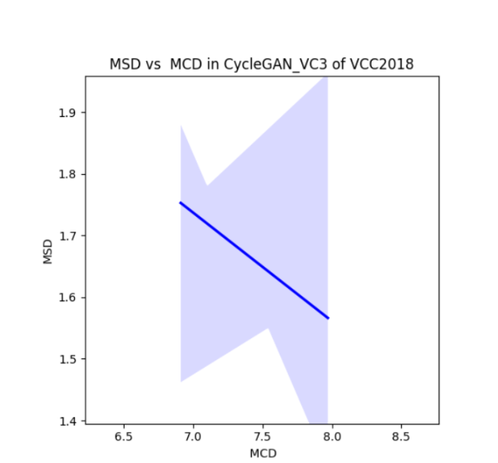
Results and Discussions (Contd.):
Fig-9: Correlation Plots between Objective Metrics MCD , MSD and Subjective Metric MOS for CycleGAN-VC3 on VCC2018 Dataset

Slide 20
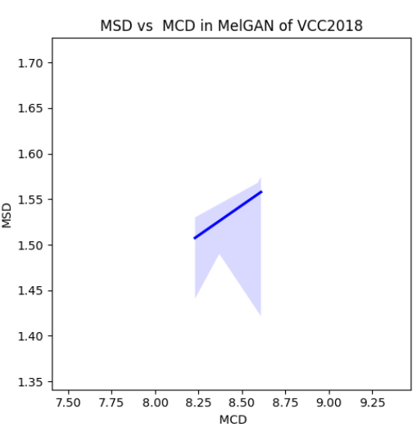
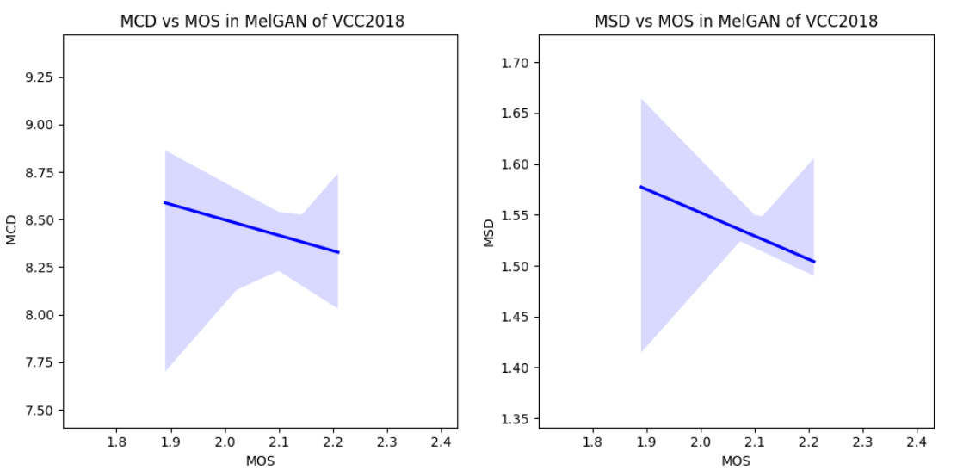
Results and Discussions (Contd.):
Fig-10: Correlation Plots between Objective Metrics MCD , MSD and Subjective Metric MOS for MelGAN-VC on VCC2018 Dataset

Slide 21
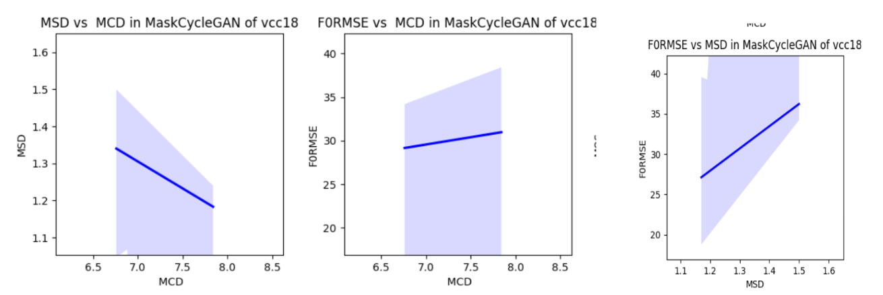
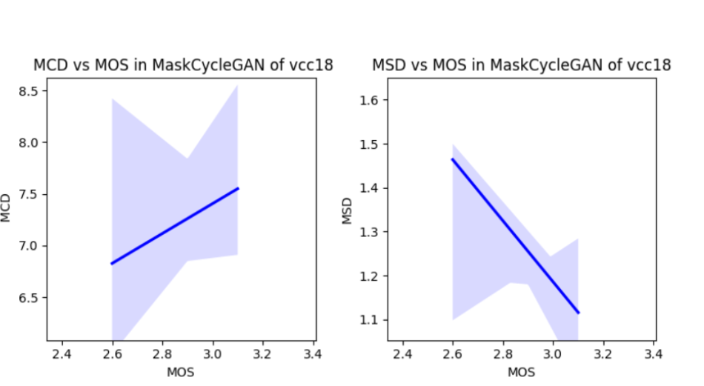
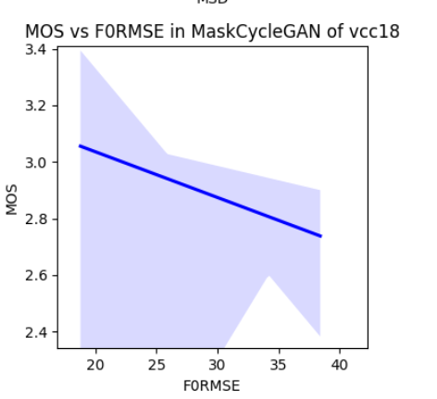
Results and Discussions (Contd.):
Fig-11: Correlation Plots between Objective Metrics MCD , MSD, F0 RMSEand Subjective Metric MOS for MaskCycleGAN-VC on VCC2018 Dataset

Slide 22
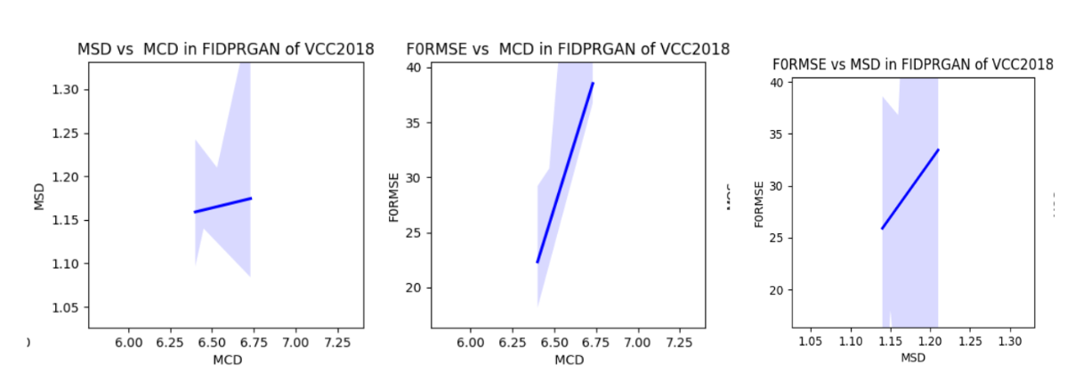
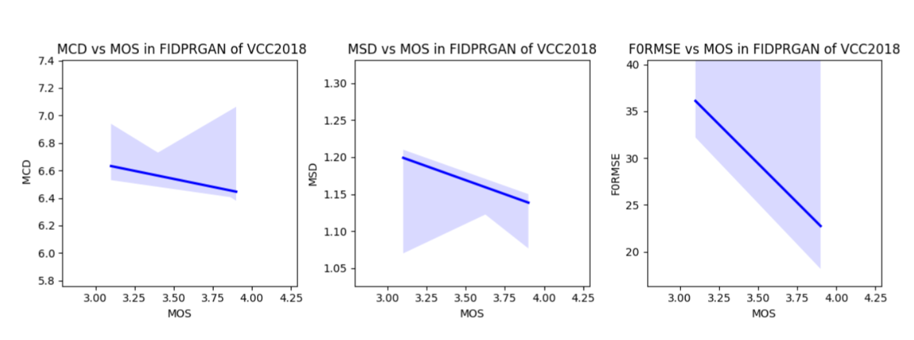
Results and Discussions (Contd.):
Fig-12: Correlation Plots between Objective Metrics MCD , MSD, F0 RMSE and Subjective Metric MOS for FIDPRGAN-VC on VCC2018 Dataset

Slide 23
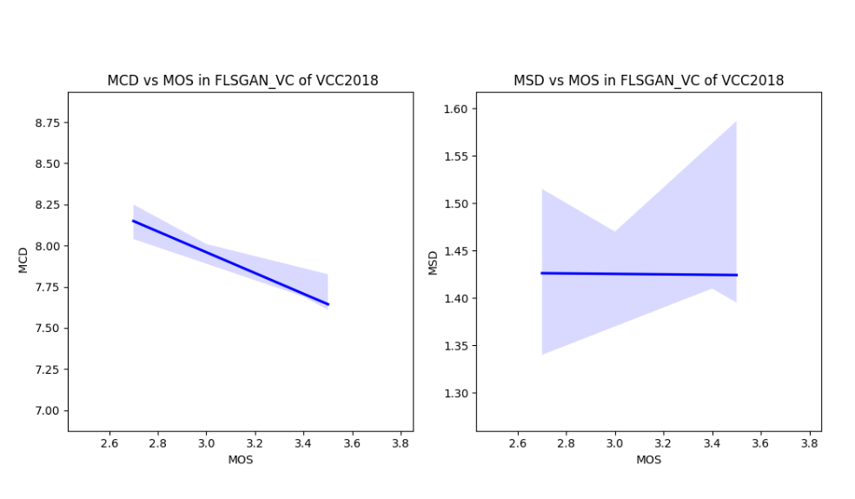
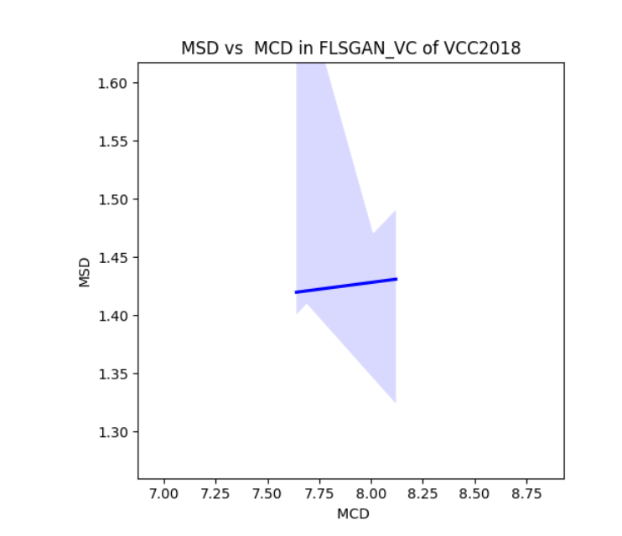
Results and Discussions (Contd.):
Fig-13: Correlation Plots between Objective Metrics MCD , MSD and Subjective Metric MOS for FLSGAN-VC on VCC2018 Dataset

Slide 24
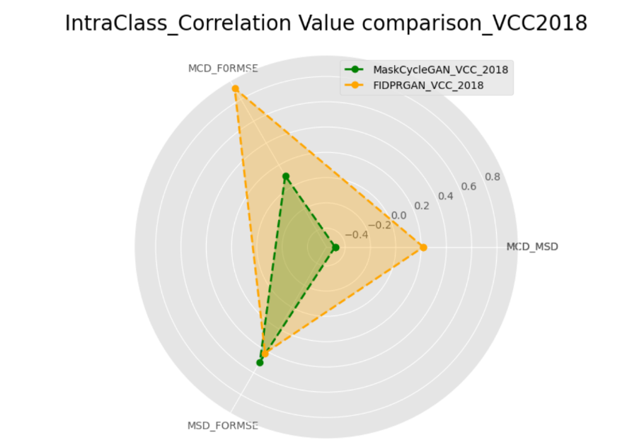
Results and Discussions (Contd.):
Fig-14: Radar plot for IntraClass Correlation Comparison between MaskCycleGAN and FIDPRGAN of VCC2018 Dataset

Slide 25
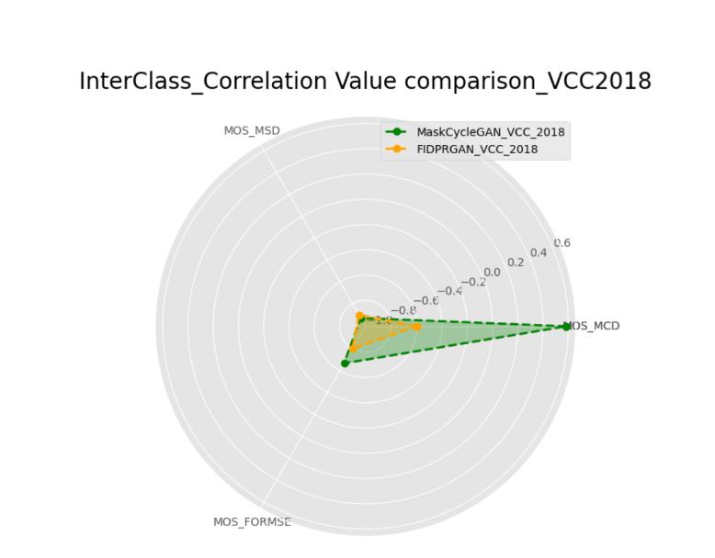
Results and Discussions (Contd.):
Fig-15 Radar plot for InterClass Correlation Comparison between MaskCycleGAN and FIDPRGAN of VCC2018 Dataset

Slide 26
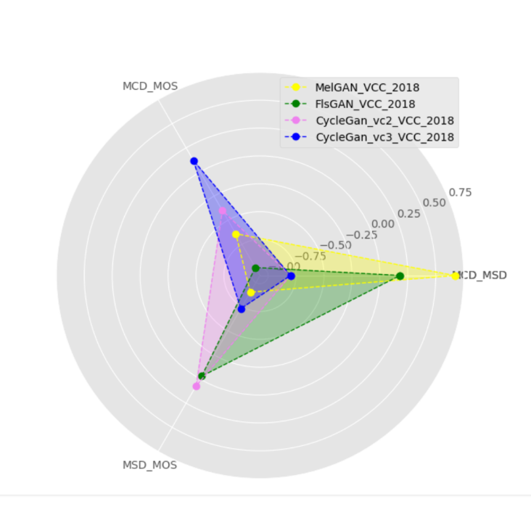
Results and Discussions (Contd.):
Fig-16: Radar plot for Correlation Comparison among MelGAN, FlsGAN, CycleGAN VC2 and CycleGAN VC3 of VCC2018 Dataset

Slide 27
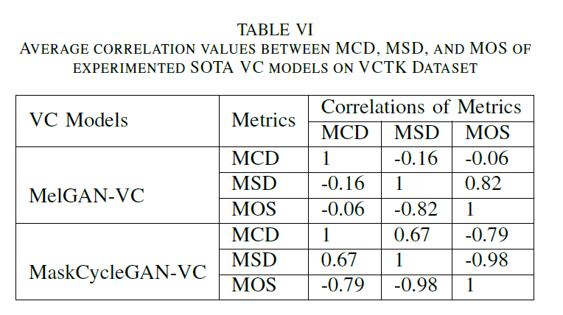
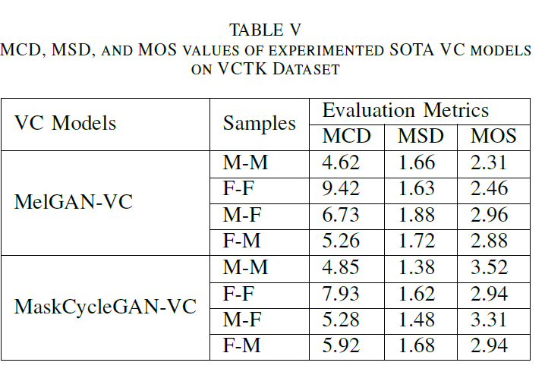
Results and Discussions (Contd.):

Slide 28
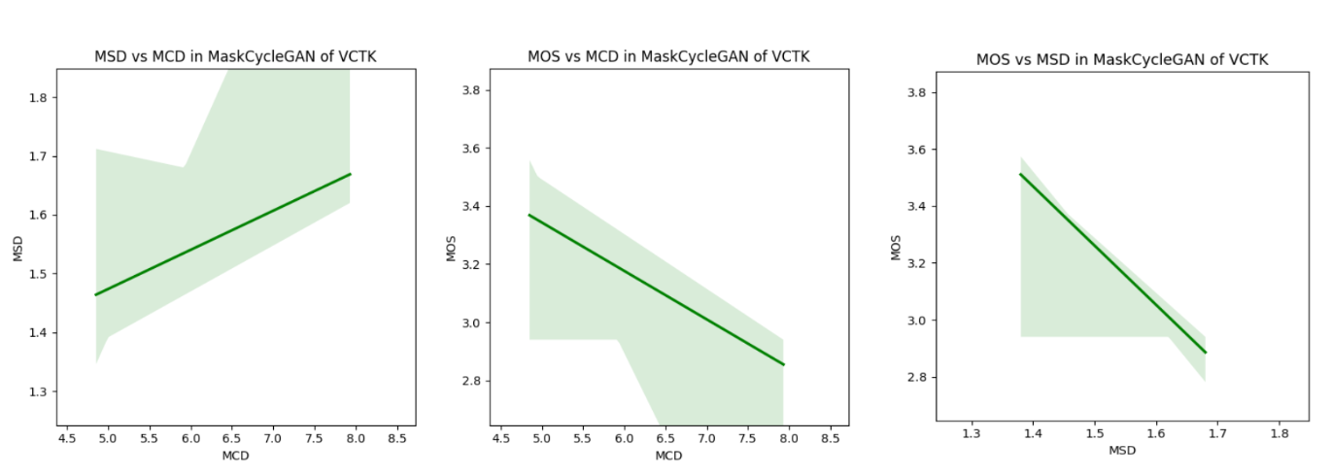
Results and Discussions (Contd.):
Fig-17: Correlation Plots between Objective Metrics MCD , MSD and Subjective Metric MOS for MaskCycleGAN on CSTR VCTK Dataset

Slide 29
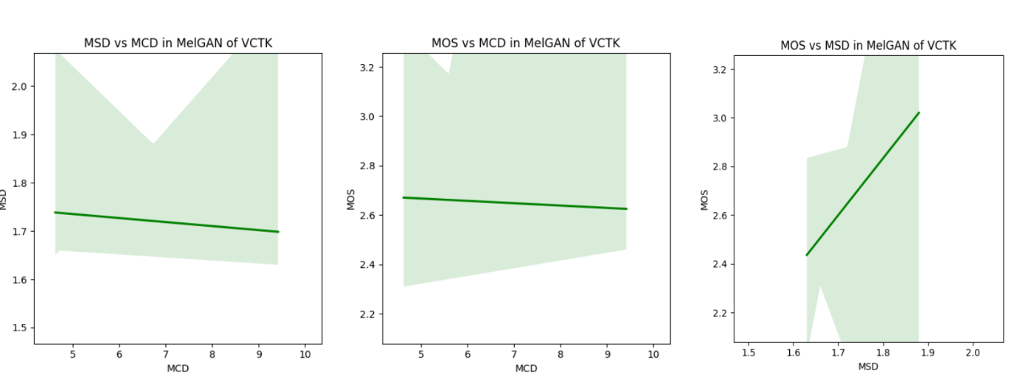
Results and Discussions (Contd.):
Fig-18: Correlation Plots between Objective Metrics MCD , MSD and Subjective Metric MOS for MelGAN on CSTR VCTK Dataset

Slide 30
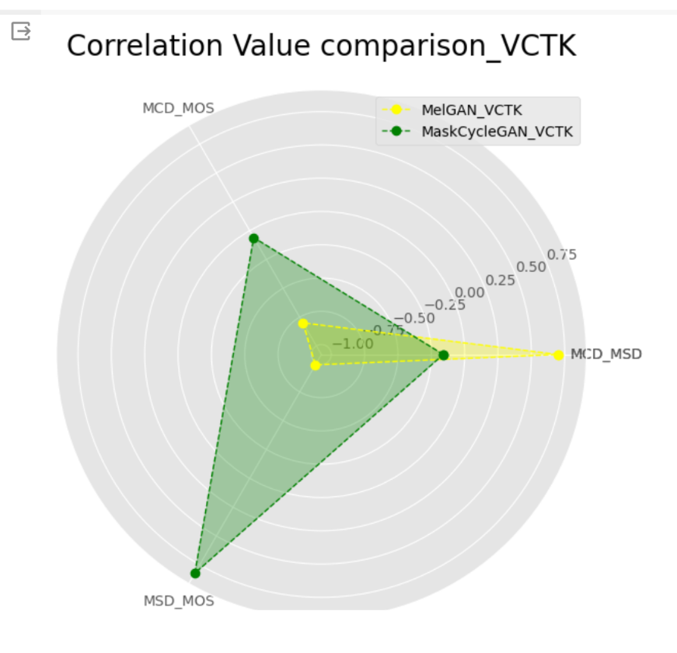
Results and Discussions (Contd.):
Fig-19: Radar Plot showing Intra Class Correlation for voice conversion outputs from MaskCycleGAN and MelGAN

Slide 31
Conclusion
This study has thoroughly examined the correlations between various evaluation metrics in the context of VC technologies.
The experimental analysis reveals the significant relationships between metrics such as MCD, MSD, F0-RMSE, and MOS.
The findings provide valuable insights into the reliability and consistency of different evaluation methods in assessing the quality of VC outputs.
Overall, this work contributes to a deeper understanding of evaluation techniques in VC research with laying the foundation for further advancements in this field.
The future research includes the enhancement of the robustness and accuracy of VC evaluation, ultimately leading to more effective VC technologies.

Slide 32
References
1. H. Du, X. Tian, L. Xie, and H. Li, “Optimizing voice conversion network with cycle consistency loss of speaker identity,” 2020.
2. S. Takamichi, T. Toda, A. W. Black, G. Neubig, S. Sakti, and S. Nakamura, “Postfilters to modify the modulation spectrum for statistical parametric speech synthesis,” IEEE/ACM Transactions on Audio, Speech,and Language Processing, vol. 24, no. 4, pp. 755–767, 2016.
3. R. C. Streijl, S. Winkler, and D. S. Hands, “Mean opinion score (mos) revisited: methods and applications, limitations and alternatives,” Multimedia Systems, vol. 22, no. 2, pp. 213–227, 2016.
4. A. W. Black, “Cmu wilderness multilingual speech dataset,” in ICASSP 2019-2019 IEEE International Conference on Acoustics, Speech andSignal Processing (ICASSP), pp. 5971–5975, IEEE, 2019.
5. L.-J. Liu, Z.-H. Ling, Y. Jiang, M. Zhou, and L.-R. Dai, “Wavenet vocoder with limited training data for voice conversion.,” in Interspeech, pp. 1983–1987, 2018.
6. N. Liang, W. Xu, C. Luo, and W. Kang, “Learning the front-end speech feature with raw waveform for end-to-end speaker recognition,” in Proceedings of the 2020 6th International Conference on Computing and Artificial Intelligence, pp. 317–322, 2020.

Slide 33
Thank You!!

